Slide 1

Seminar 8
Liu Ziyuan
Wang Xingyi
You Yinjie
Class2213 Group 8
Notes:
添加设计方向、设计独特性、n应用要扩充；建设内容要扩充；李处建议：1、个人身份介绍，我是陕西高等教育大数据中心主任**，我代表教育厅汇报。。。设计情况 2、简单介绍书 ，很多做了拉页处理，大事记可以放到ppt，在省政务大数据局支持和指导下，投入多少人多少天完成项目3、

Slide 2
Division of Work
Liu Ziyuan: Slide of Part1, Result Analysis
You Yinjie: Slide of Part2, Result Analysis
Wang Xingyi: Whole Simulation Model, Slide of Part 3

Slide 3
CONTENTS
01
PFC-BOOST and Operating Principles
02
Current Loop
Hysteresis Control
PART
PART
03
Power Factor Correction
with Voltage Loop
PART

Slide 4
PART. 01
PFC-BOOST and its Operating Principle

Slide 5
Simulation Model
BOOST circuit:
Target:
By properly controlling the on-off of the switch, the input current and the grid voltage have the same phase. Therefore the power factor of the grid is approximately equal to 1.
Figure 1-1 : PFC-BOOST structure

Slide 6
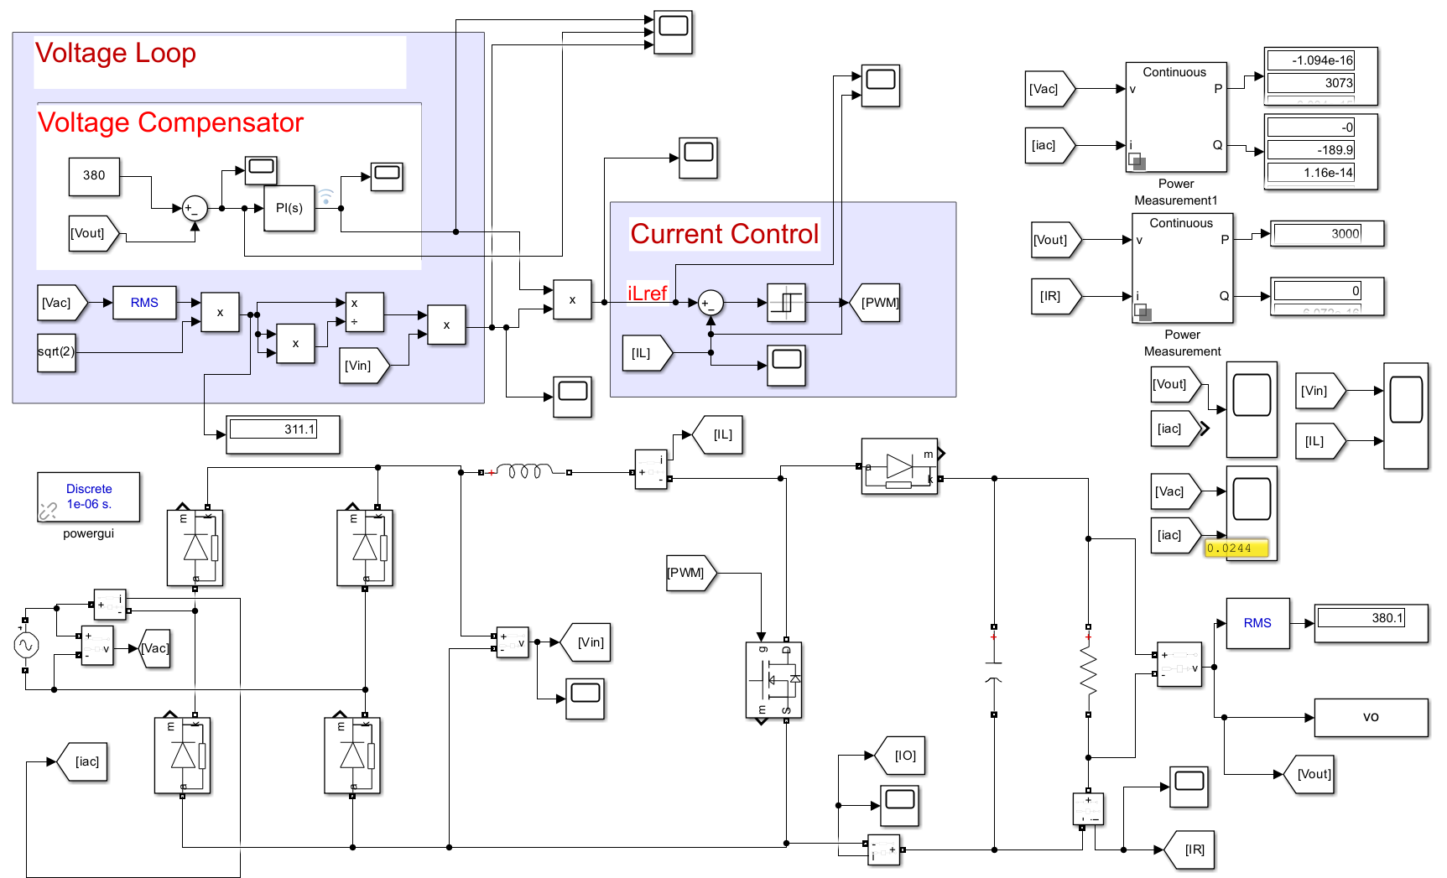
Simulation Model
Parameters | values
DC side voltage Uin | 220V
Target output voltage | 380V
Target output power | 3000w
Parallel capacitor C | 470*3μF
Inductance L | 700μH
Figure 1-2 : PFC-BOOST simulation model

Slide 7
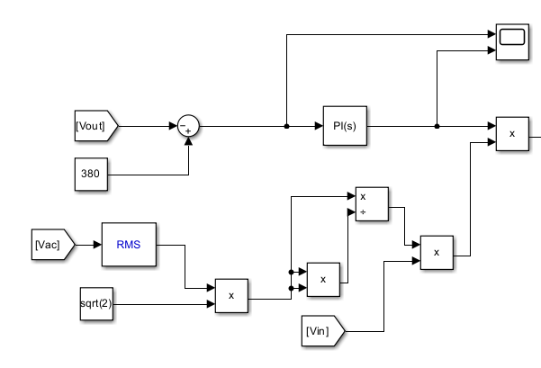
Operating principles
Task for voltage loop:
Obtain the inductance current instruction value i_{L}
PI regulator:
Obtain the effective value of the target inductor current.
The waveform of the target inductor current can be obtained by multiplying with sine half wave
Figure 1-3: Voltage loop control

Slide 8
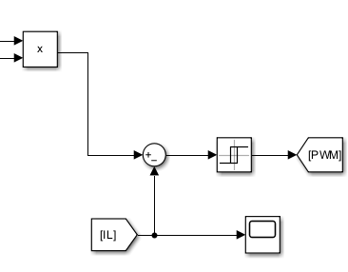
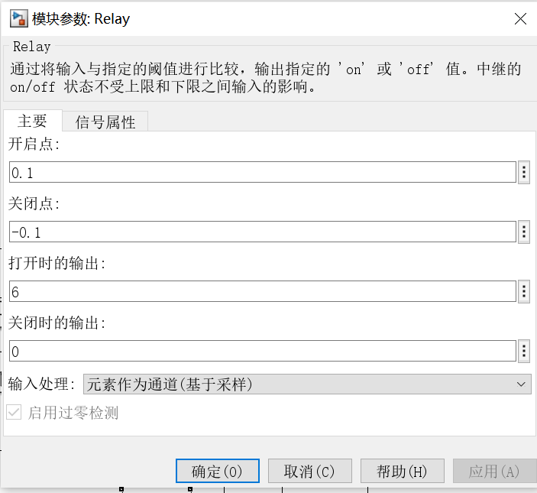
Operating principles
Figure 1-4: Current loop control
Task for current loop:
Generate control signal for the switch Q. Hysteresis current control method is adopted rather than Carrier wave.
Hysteresis current control:
Set the range, which is 0.1A here.
Figure 1-5: Parameter set for comparator

Slide 9
Current Loop Control
PART. 02

Slide 10
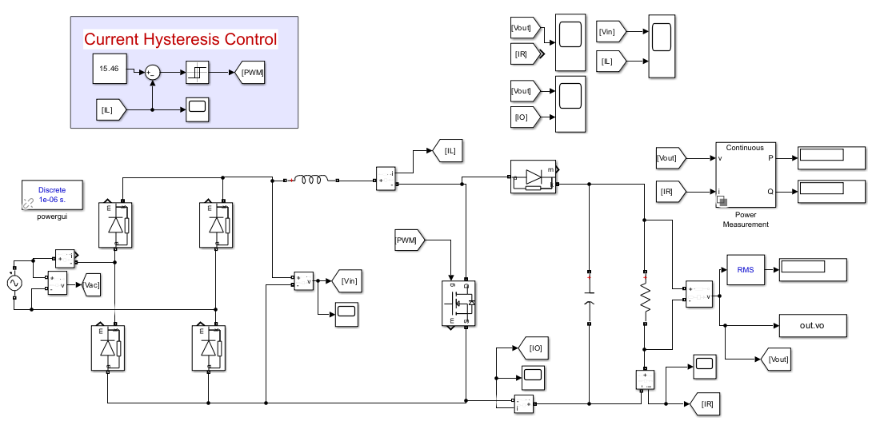
Simulation Model
Figure 2-1: Circuit of Current Loop Controlled PFC
inductive current->compare with the average value->PWM-> control the inductive current
Best commanding current:
15.46A
Notes:
circuit diagram
trigger signal of thyristor
The natural commutation point of the three-phase fully controlled bridge is set to 30 degree, and the delay angel α is 40 degree. VT1 conducts from 70 to130.VT2 conducts from 130 to 250.

Slide 11
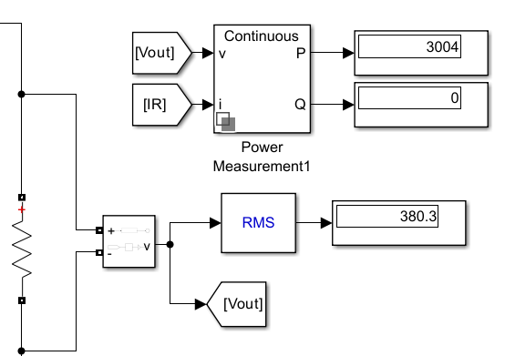
Simulation Result
 | Theoretical value | Simulation value | Error
Output voltage/V | 380 | 380.3 | 0.0789%
Output power/W | 3000 | 3004 | 0.1333%
Figure 2-2: Output Voltage and Power
Notes:
circuit diagram
trigger signal of thyristor
The natural commutation point of the three-phase fully controlled bridge is set to 30 degree, and the delay angel α is 40 degree. VT1 conducts from 70 to130.VT2 conducts from 130 to 250.

Slide 12
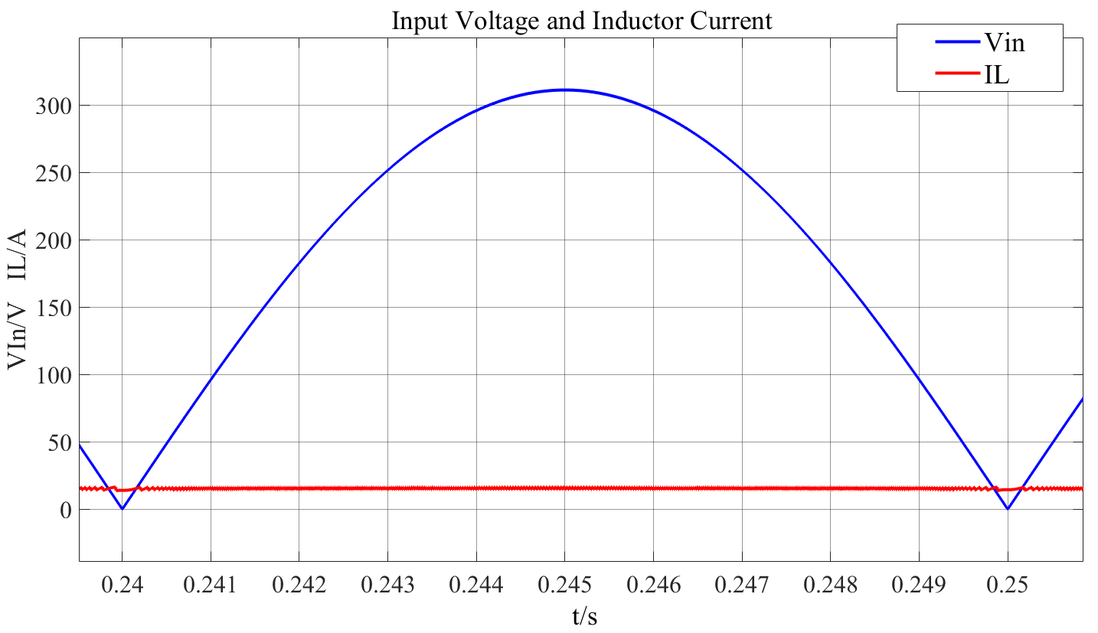
Simulation Result
Voltage: like a sine waveform but greater than 0
Current: controlled in a small boundary near 15.46A
Figure 2-3: Waveform of Input Voltage and Inductor Current
Notes:
circuit diagram
trigger signal of thyristor
The natural commutation point of the three-phase fully controlled bridge is set to 30 degree, and the delay angel α is 40 degree. VT1 conducts from 70 to130.VT2 conducts from 130 to 250.

Slide 13
Power Factor Correction
PART. 03

Slide 14
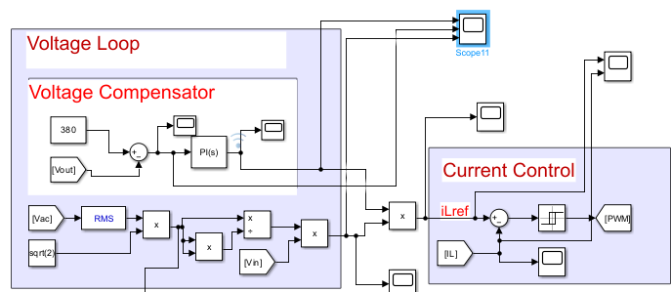
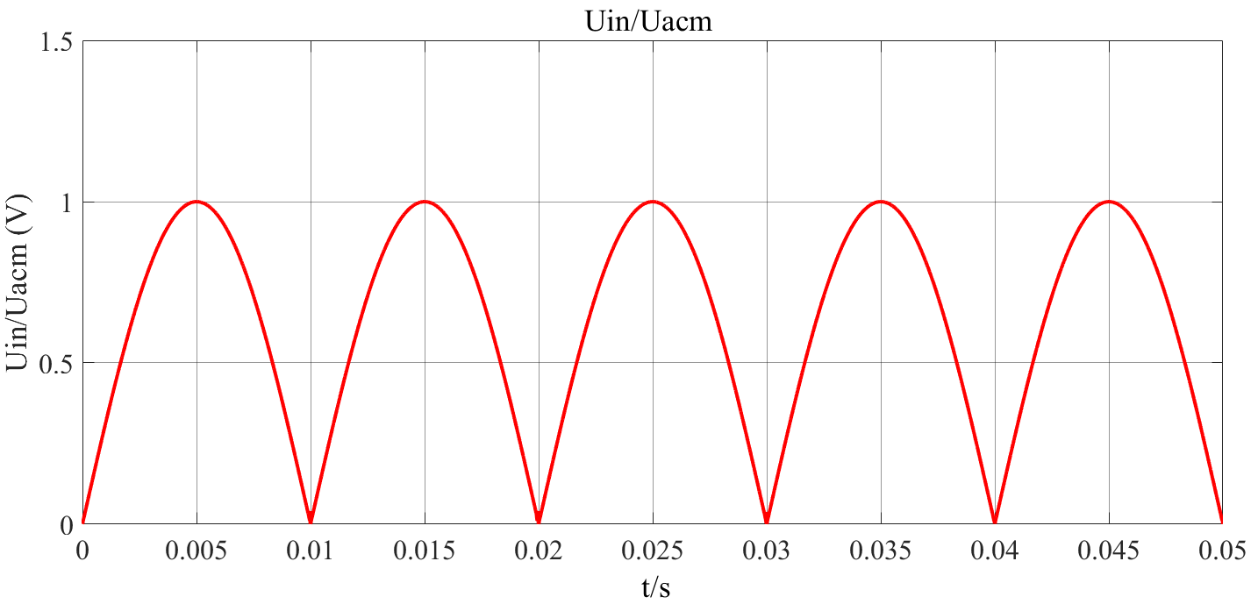
Control Circuit
Figure 3-2 Circuit Diagram
Figure 3-1 Control Circuit With Outer Voltage Loop
Figure 3-3 Output Waveform of Lower Part

Slide 15
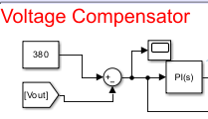
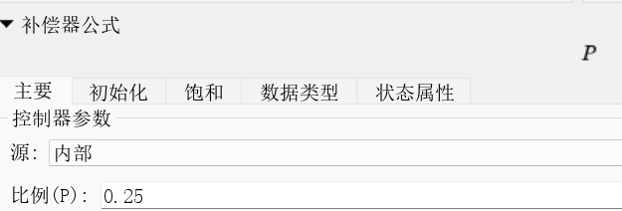
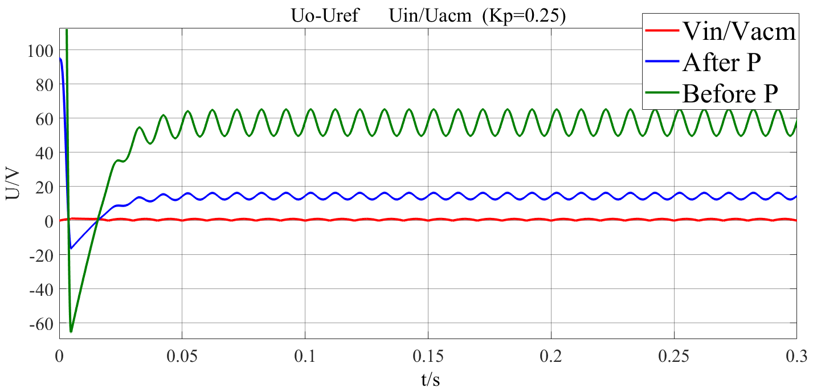
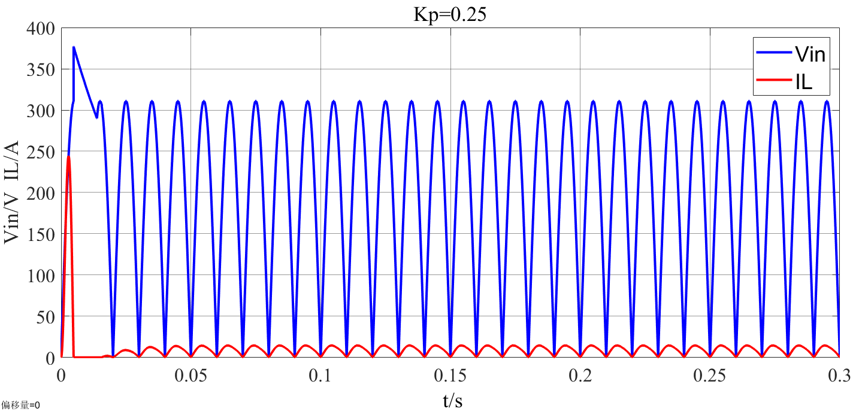
Proportional
Kp=0.25<1
Figure 3-4 Error Signals with P Block (Kp<1)
Figure 3-5 Inductor Current and Input DC Voltage with Kp=0.25
Notes:
circuit diagram
trigger signal of thyristor
The natural commutation point of the three-phase fully controlled bridge is set to 30 degree, and the delay angel α is 40 degree. VT1 conducts from 70 to130.VT2 conducts from 130 to 250.

Slide 16
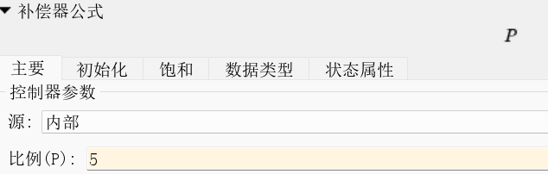
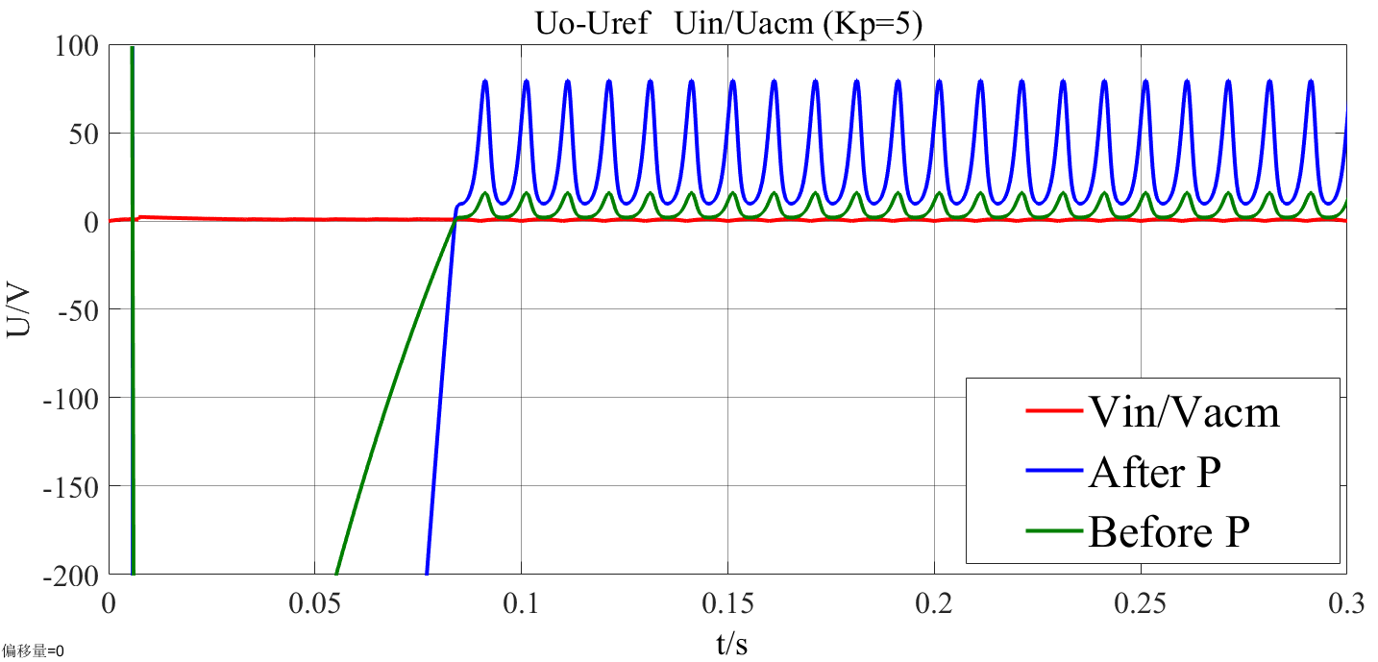
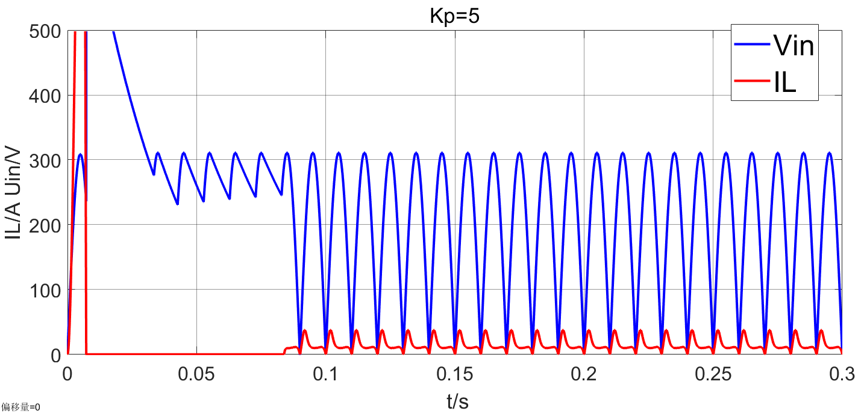
Proportional
Kp=5>1
Figure 3-6:Error Signals with P Block (Kp>1)
Figure 3-7: Inductor Current and Input DC Voltage with Kp=5
Notes:
circuit diagram
trigger signal of thyristor
The natural commutation point of the three-phase fully controlled bridge is set to 30 degree, and the delay angel α is 40 degree. VT1 conducts from 70 to130.VT2 conducts from 130 to 250.

Slide 17
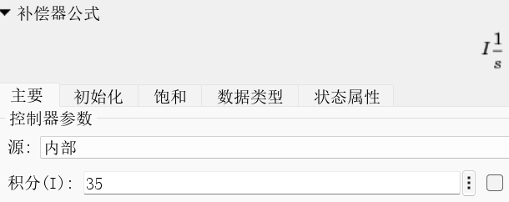
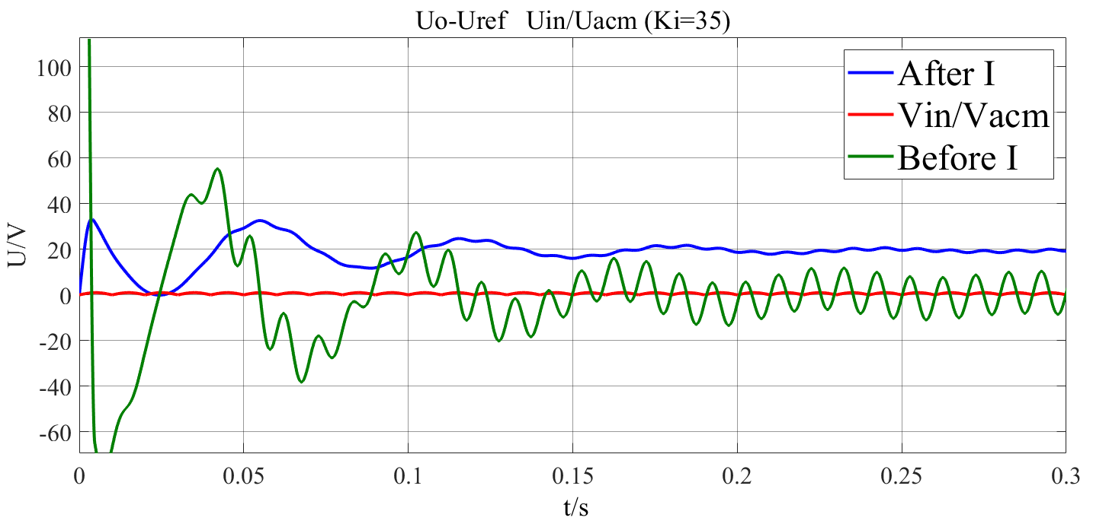
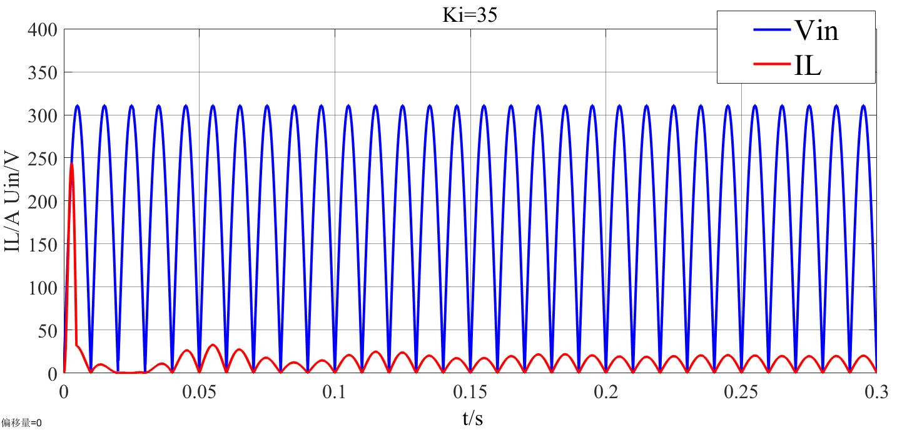
Integral
Ki=35
Figure 3-8:Error Signals with Integral Block
Figure 3-9: Inductor Current and Input DC Voltage with Ki=35
Notes:
circuit diagram
trigger signal of thyristor
The natural commutation point of the three-phase fully controlled bridge is set to 30 degree, and the delay angel α is 40 degree. VT1 conducts from 70 to130.VT2 conducts from 130 to 250.

Slide 18
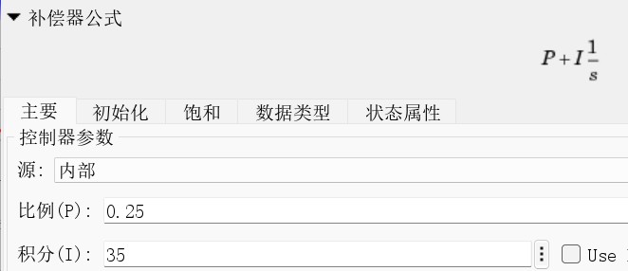
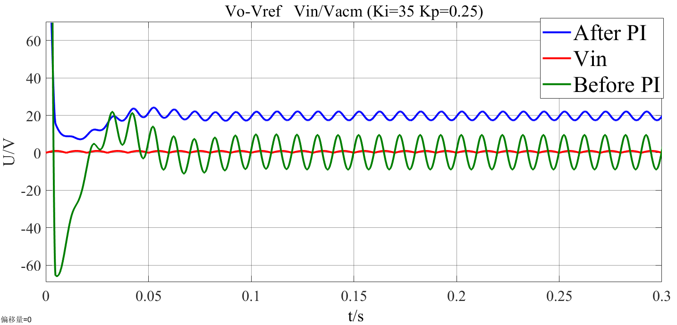
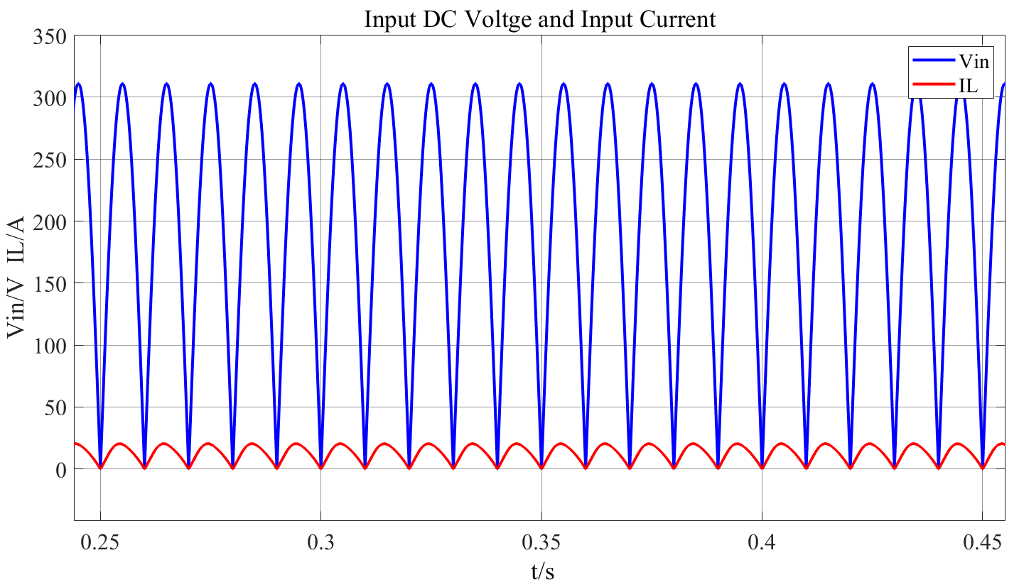
PI Block
Kp=0.25
Ki=35
Figure 3-10: Error Signals with PI Block
Figure 3-11: Inductor Current and Input DC Voltage with Ki=35, Kp=0.25
Notes:
circuit diagram
trigger signal of thyristor
The natural commutation point of the three-phase fully controlled bridge is set to 30 degree, and the delay angel α is 40 degree. VT1 conducts from 70 to130.VT2 conducts from 130 to 250.

Slide 19
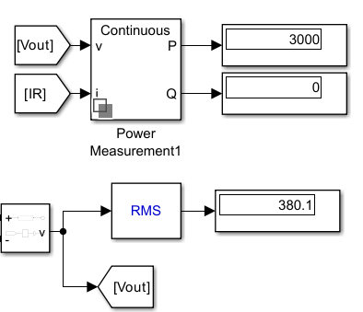
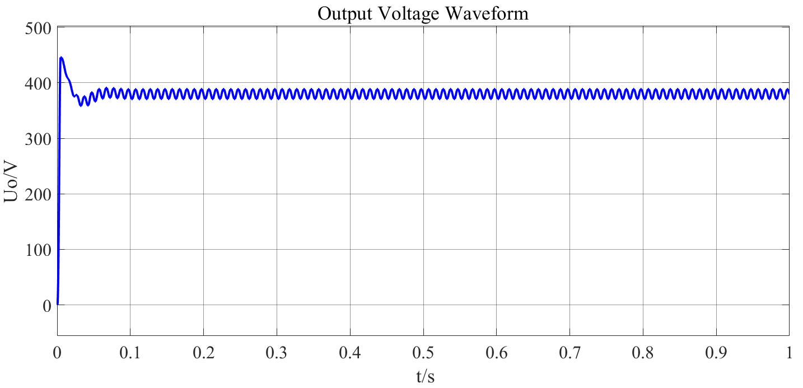
Output Result
Figure 3-12: Output Result with Ki=35, Kp=0.25
Figure 3-13: Output Waveform
Notes:
circuit diagram
trigger signal of thyristor
The natural commutation point of the three-phase fully controlled bridge is set to 30 degree, and the delay angel α is 40 degree. VT1 conducts from 70 to130.VT2 conducts from 130 to 250.

Slide 20
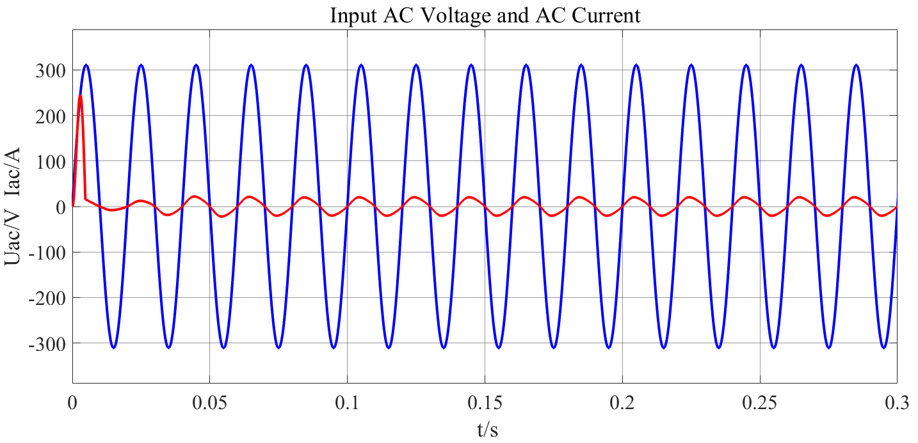
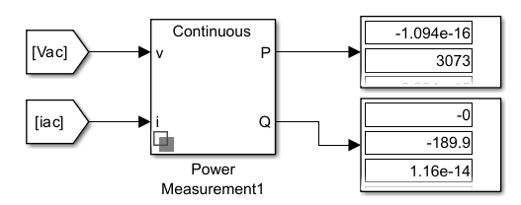
Grid Side
Figure 3-14: Power Measurement of AC side
Figure 3-15: Input AC Current and AC Voltage
Figure 3-16: Input DC Voltage and Current
Notes:
circuit diagram
trigger signal of thyristor
The natural commutation point of the three-phase fully controlled bridge is set to 30 degree, and the delay angel α is 40 degree. VT1 conducts from 70 to130.VT2 conducts from 130 to 250.

Slide 21
Thanks！

